Slide 1
Dec. 6, 2023 Welcome to the Fourth Grade Parent Meeting

Slide 2
THE ADMINISTRATORS Ms. Jermeka Ford, Principal Mrs. Christina Iwanski, Assistant Principal

Slide 3
THE SUPPORT STAFF Mrs. N. Smith, Counselor Dr. R. Summers, Multi-Tiered Support

Slide 4
THE TEACHERS Mrs. Britt – Math Mr. Dennies – Science and Social Studies Mrs.Letts – English Language Arts

Slide 5
THE AGENDA
Teachers share some important information with 4th grade families.
Administrators will open the floor for questions / answers.

Slide 6
Geogia Milestones Assessment ELA April 23 & 24 Math April 26 Retest May 15 & 16
*Dates are dependent on the GA Dept. of Education’s schedule and are subject to change.

Slide 7
Content Mastery Assessment CMA 1 Sep. 25 –Oct. 13 CMA 2 Dec. 4 – 15 CMA 3 Feb. 26 - Mar . 15 Standards covered can be found on www.gastandards.org and each teacher’s school webpage.

Slide 8
*CMAs are modeled after the GA Milestones Assessment * Online, Independent Work,& Accommodations Provided * Requires higher order thinking skills such as making models, explaining & writing essay type responses

Slide 9
ELA I- Ready Expectations Beginning of the Year 557-578 Middle of the Year 579-602 End of the Year 603-629 Gains needed over 30 weeks for 1 year growth – 22 points 1.5 years growth – 47 points 2 years growth – 62 points

Slide 10
Math I- Ready Expectations Beginning of the Year 465-483 Middle of the Year 484-516 End of the Year 517-526 Gains needed over 30 weeks for 1 year growth – 19 points 1.5 years growth – 41 points 2 years growth – 54 points

Slide 11
THE ELA SCORES as of September 2023 On Grade level= 7 1 Year Behind = 22 2 or More Years Behind =31
*The I-Ready Score Labels are on the Progress Reports.

Slide 12
THE Math SCORES as of September 2023 On Grade level= 1 1 Year Behind = 17 2 or More Years Behind = 49 *The Iready Scores Labels are on the Progress Reports.

Slide 13
Promotion Requirements Earn 70% -100% final average Must earn at least 70% in ELA , Math and pass 2 out of the 3 courses below: Science, Social Studies, Health

Slide 14
Infinite Campus Login Instructions Please take a copy of the instructions home. See the Data Clerk if you do not know your username/password. Contact Ms. Cheatham for any additional assistance with Infinite Campus. Please check for grades/attendance in IC.

Slide 15
Progress Report Dates Fall- Sep. 15, Oct. 27 Spring – Feb. 15 , Mar. 28 Report Card Dates Jan.9 , May 28 Parent /Teacher Conference Dates Sep. 18-Oct. 6 Calendars are on www.rcboe.org under the parent tab.

Slide 16
Behaviors that Support Learning Attendance Assignment Turn In/ Make Up Work Homework Conduct

Slide 17
Behavior That Supports Learning: ATTENDANCE Students can not be taught if they are not present. There is no substitute for live instruction. The conversations had are an important part of the lessons taught. Instruction goes on from 8:20 to 3:00. Please make every effort to have your child present all day. Attendance affects our CCRP Score. Parents can send in 5 excuses, the rest must come from an official appointment, e.g. a Doctor’s or Social Security Office appointment. It is the students responsibility to make up assignments within 2 days of an excused absence.

Slide 18
Behavior That Supports Learning: ASSIGNMENT TURN IN / MAKE UP WORK Students are responsible to turning in assignments on the due date specified by the teacher that assigned it.

Slide 19
Canvas : Our Learning Management System This is the icon for the app. You can follow your child in the app on your phone. When your children are absent the lesson plans/ assignment are available online.

Slide 20
Behavior that Supports Learning; HOMEWORK - Homework is sent home daily per the BOE so that parents can take an active role in the students academic growth and know the students strengths and challenges. We do what gets checked, please be sure to sit down with your child and discuss the homework. Make sure it is legible, complete and put in the bookbag before your child comes to school. It helps them be ready to learn.

Slide 21
FEV Tutor Free Online Tutoring App on the Launchpad at www.rcboe.org Work on phones, tablets, laptops, computers Homework Help On Demand Setup Weekly Tutoring * Used for Limited Intervention in School

Slide 22
FEV Tutoring Impact Data for Jamestown Math – Average gains of 2 points for strugglers not engaged with FEV tutors Math – Average gain of 19 points for strugglers engaged with FEV tutors Remember 1 year growth for Math I- Ready was 22 points. So FEV Tutoring has helped struggling students achieve that goal.

Slide 23
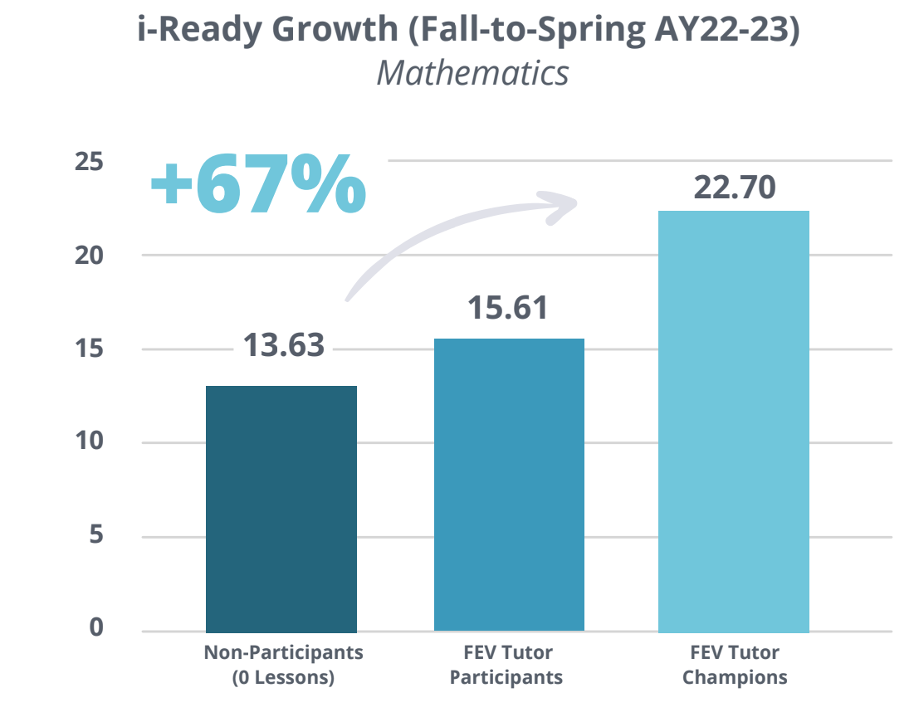
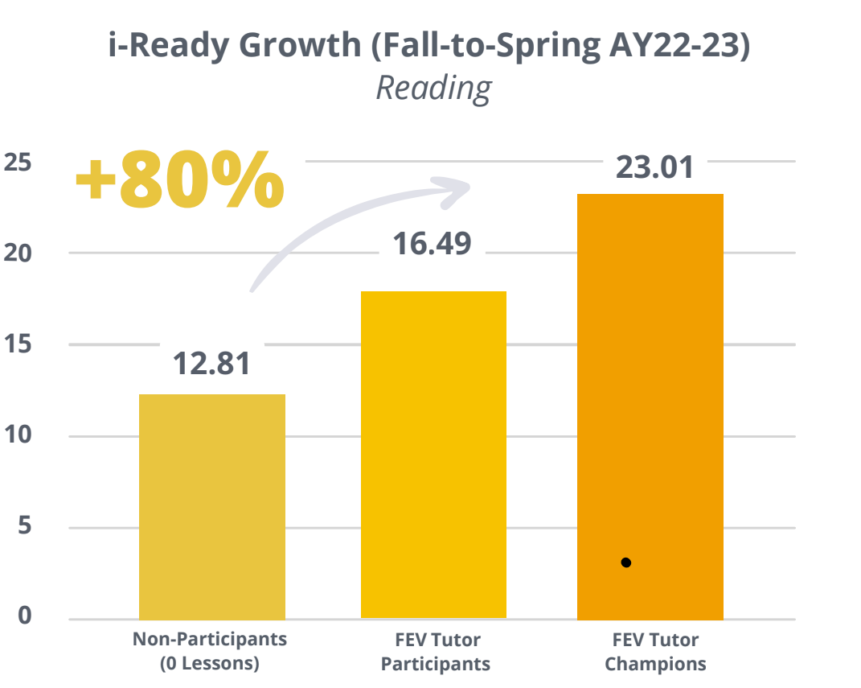
FEV Math and Reading Outcomes

Slide 24
(855) 763-2607
Call for more information.

Slide 25
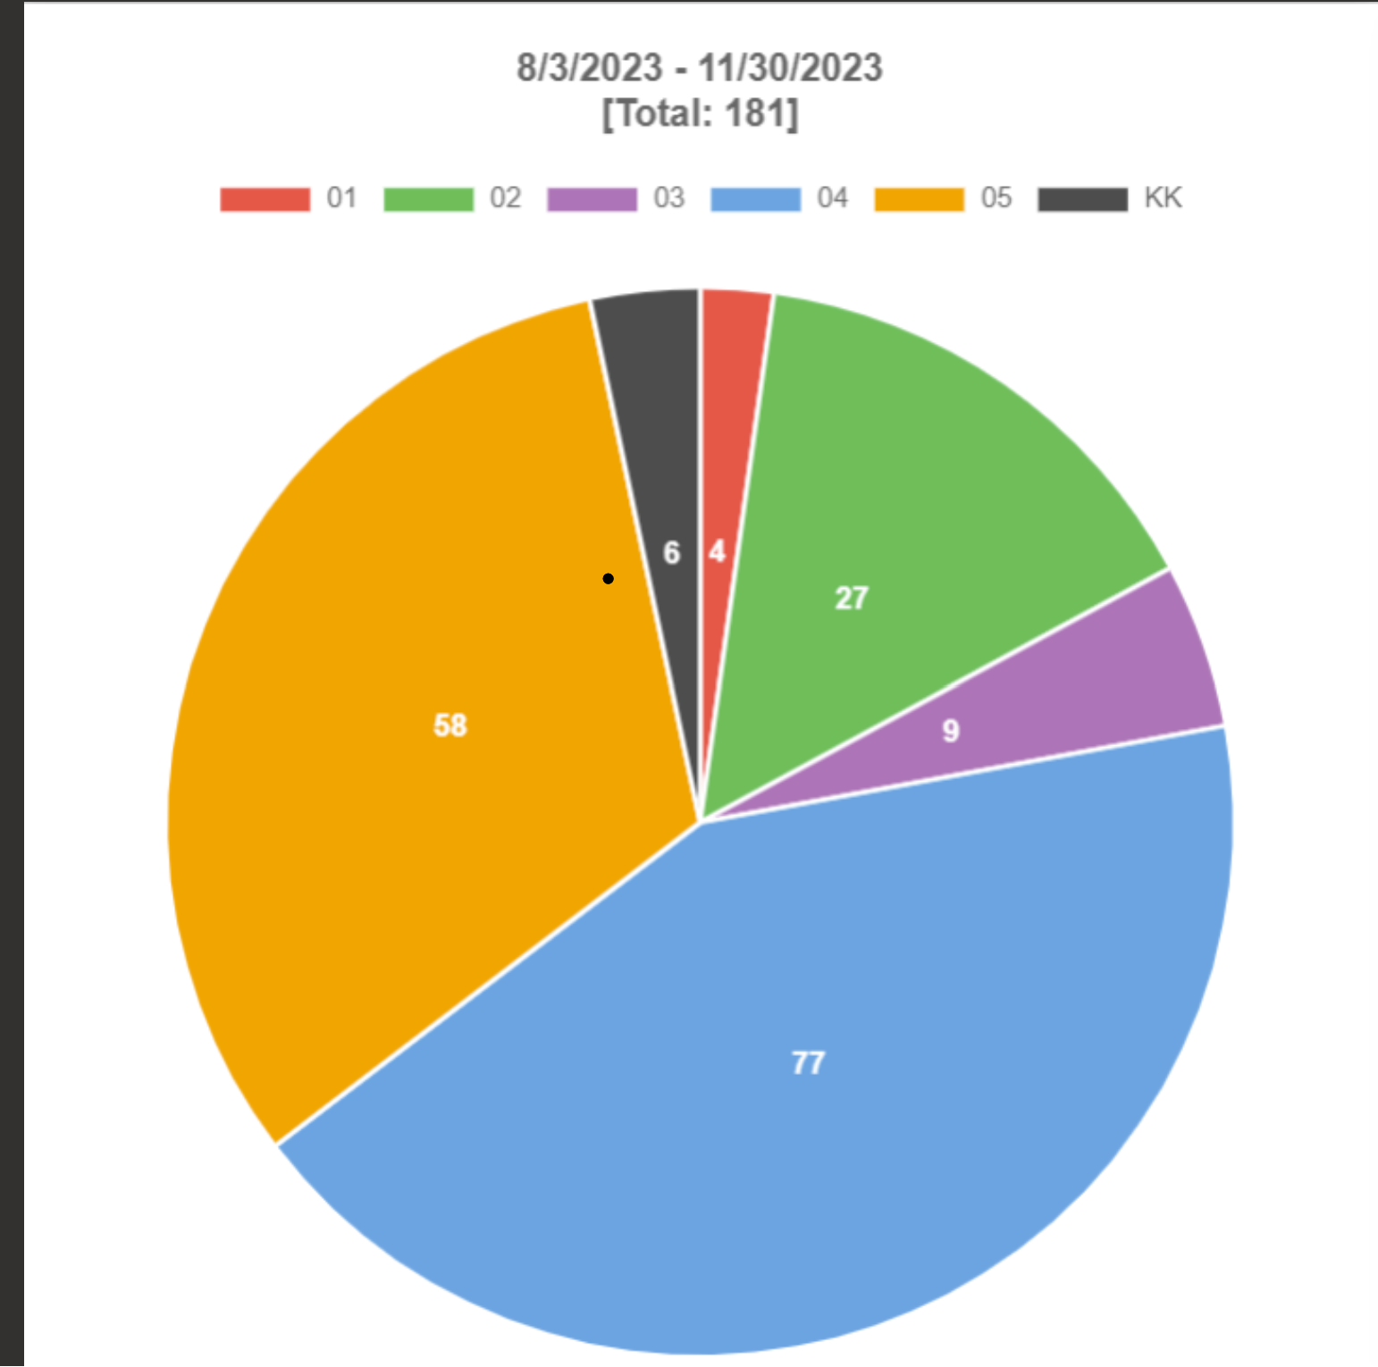
Behavior that Supports Learning: CONDUCT The take away: 4th grade has the most behavior referrals, this is impacts attendance , teaching and learning negativiely.

Slide 26
Positivity Counts PBIS

Slide 27
C.H.A.M.P. Expectations Come motivated Have respect Always follow directions Maintain safety Positivity counts *Teacher’s Rules and RCSS Code of Conduct Book were provided to all students..

Slide 28
Our Motto is Jamestown Knights Armored In Excellence Fourth grade teachers soliciting everyone’s help as we strive to encourage the students to pursue excellence through academic and behavioral growth. Thank you for attending!

